Slide 1
Comprehensive Digital Marketing Project Work On NOISE
Team Details
K J JOSEPH JERIN (TEAM LEADER)
B JOSITH NAVEEN (TEAM MEMBER)
SANA TEJASWI (TEAM MEMBER)
SOMAYAJULA SURNARAYANA (TEAM MEMBER)
KAMMA SAI SREE ANEESHA (TEAM MEMBER)
KOTTANA MADHU (TEAM MEMBER)

Slide 2
Comprehensive Digital Marketing Project Work On Noise
Team Members
Acknowledgement
I am SANA TEJASWI , as a Team Member I have done these following Work in this Project
PowerPoint Presentation
Buyers Audience Persona
SEO Audit

Slide 3
Buyers Persona
Buyers Persona :
A buyer persona—also called a user persona, marketing persona, or audience persona—is a fictional profile of your ideal customer based on market and audience research.
In other words, it’s an imaginary person that embodies the most important characteristics found within your broad audience.
Just like a real living and breathing customer, a buyer persona should have a demographic and psychographic profile, behavior trends, values, desires, pain points, and affiliations.

Slide 4
Buyers Persona
Buyers Persona :
Though the persona is fictional, the profile should be as well rounded as possible.
Generating buyer personas isn’t about describing a potential customer or a vision for business expansion.
To the contrary, the buyer persona should reflect individuals who already exist within your target market to help marketing, sales, and product departments make better decisions..

Slide 5
Buyers Persona
Buyers Persona :
Working with buyer personas can help: Guide product development Inform content generation efforts.
Provide insights for lead follow-up
Improve customer acquisition and retention strategies.
After an initial market assessment, creating buyer personas is the next logical step for businesses. This step allows businesses to understand their target market thoroughly before making significant investments in product development, marketing strategies, and sales infrastructure.

Slide 6
Buyers Persona
Buyers Persona :
In practice, buyer personas can help drive many essential processes within a company. Here are a few examples:
Product development—Buyer personas offer valuable insights into the needs, preferences, and pain points of the target audience. This understanding helps businesses develop products that meet customer needs and provide solutions to their problems.
Marketing strategy—Buyer personas help businesses understand audience motivations and behaviors, which can help craft messaging that drives engagement.

Slide 7
Buyers Persona
Buyers Persona :
Sales Infrastructure—Buyer personas can help you identify the most effective sales channels and tactics for your target audience so businesses can tailor their sales approach.
Customer Support—Buyer personas can help you provide better customer support by understanding your audience’s communication preferences and support needs.

Slide 8
SEO Audit
Report on the Audit of the Standalone :
An SEO audit is the process of evaluating how well your website is optimized for search engines.
It identifies errors that can prevent your site from ranking well and opportunities that can help you gain more visibility.
An SEO audit usually covers areas like: Indexing and crawlability User experience Site architecture Competitor bench marking
Keyword research On-page SEO Backlink profile It is basically an overall “health check” for a website.

Slide 9
SEO Audit
Report on the Audit of the Standalone :
Check for Indexing Issues Pages that are not indexed are not in Google’s database.
Google can’t rank them. To see whether your pages have been indexed, check for issues directly in Google Search Console.
Head to the “Pages” report under the “Index” section in the left menu. Here, you can see a graph of all pages based on their indexing status.

Slide 10
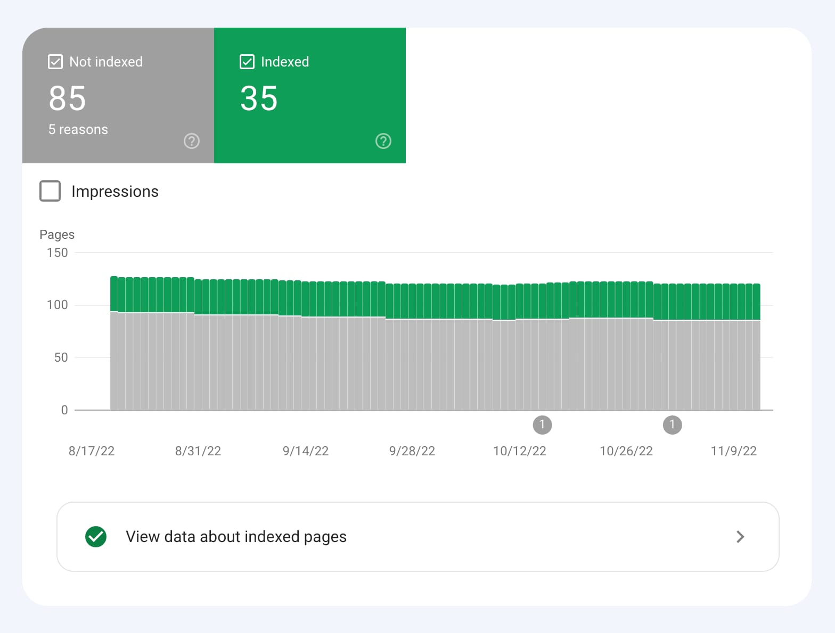
SEO Audit
Report on the Audit of the Standalone :
Check for Indexing Issues Pages that are not indexed are not in Google’s database.
Google can’t rank them. To see whether your pages have been indexed, check for issues directly in Google Search Console.
Head to the “Pages” report under the “Index” section in the left menu. Here, you can see a graph of all pages based on their indexing status.

Slide 11
SEO Audit
Report on the Audit of the Standalone :
Check for Duplicate Versions of Your SiteIt is essential to ensure that Google is indexing only one version of your site. Your site could sit on various versions of a URL (depending on whether there’s WWW in the domain and whether your site uses HTTPS).
To a search engine, these are all different versions of the site: http://www.yoursite.com
http://yoursite.comhttps://
www.yoursite.comhttps:/
If your website runs on more than one of these URL versions, it can cause many issues with crawling, indexing, and ranking. Especially because Google will take them as duplicates.

Slide 12
SEO Audit
Report on the Audit of the Standalone :
Run a Site Crawl
A good SEO audit is crawl-based.
That means you should be able to simulate the way Google crawls your pages.
And see all issues related to those pages the way Google might see them.
To do that, you’ll need a website SEO auditing tool like Site Audit.
First, you’ll create a project and set up the audit.

Slide 13
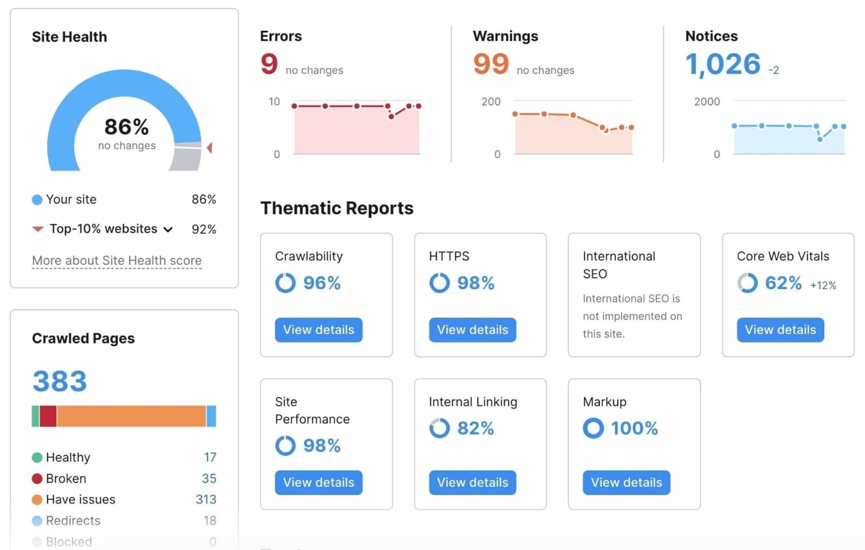
SEO Audit
Report on the Audit of the Standalone :
Run a Site Crawl
A good SEO audit is crawl-based.
That means you should be able to simulate the way Google crawls your pages.
And see all issues related to those pages the way Google might see them.
To do that, you’ll need a website SEO auditing tool like Site Audit.
First, you’ll create a project and set up the audit.

Slide 14
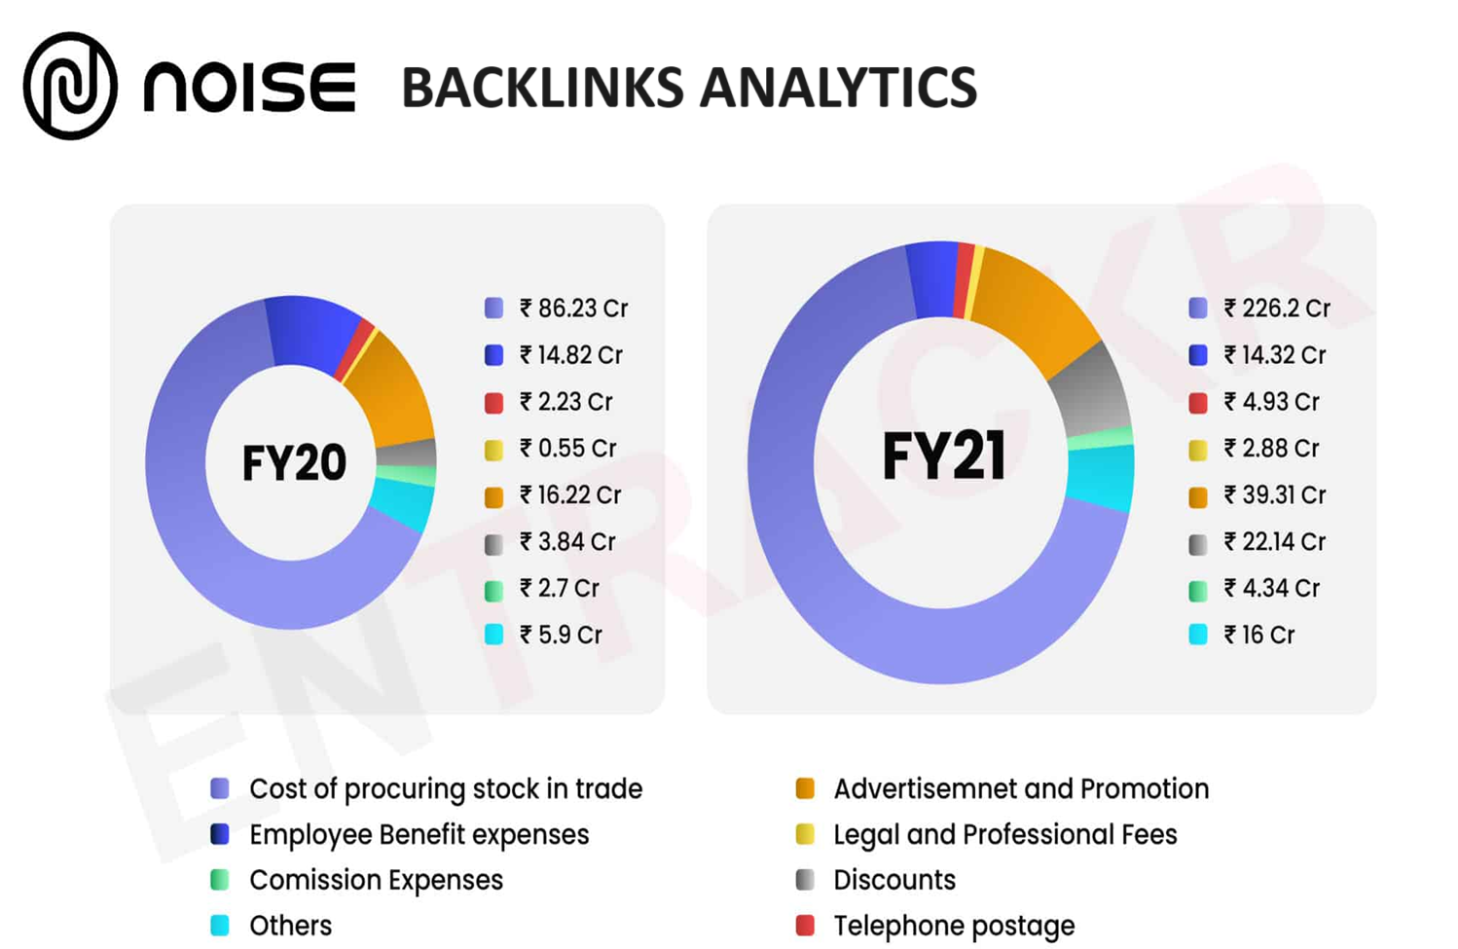
SEO

Slide 15
Lessons Learned :
Consistency is Key: Consistency in content creation helps to establish brand recognition and build a loyal audience. Maintaining a consistent brand voice, visual identity, and posting schedule creates a cohesive brand experience for the audience.
Quality Over Quantity: While it's important to consistently create content, focusing on quality should take precedence over quantity. Well-produced and thoughtful content tends to have a more significant impact and can lead to higher engagement and brand loyalty.
Building Relationships and Collaborations: Collaboration with influencers, partners, or customers can provide fresh perspectives and expand the reach of the brand's content. Collaborations help tap into new audiences, bring in diverse ideas, and create engaging content.

